Slide 1


SOFTWARE Design & Analysis (Week-2)
Usama Musharaf
MS-CS (Software Engineering)
Lecturer (Department of Computer Science)
FAST-NUCES Peshawar

Slide 2
Agenda of week # 2
Software Development Process Models
Requirement Engineering
Analysis Modeling

Slide 3
Software process models

Slide 4
What is a software process?
SP is a set of activities whose goal is the development or evolution of software.
Fundamental activities in all software processes are:
Specification - what the system should do and its development constraints.
Development - production of the software system (design and implementation)
Validation - checking that the software is what the customer wants
Evolution - changing the software in response to changing demands

Slide 5
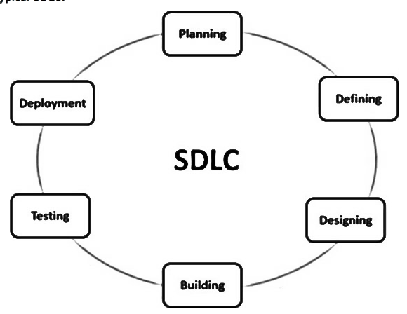
Software Development Life Cycle

Slide 6
Software process models
Waterfall model
V Model
Rapid prototyping model
Evolutionary s/w process Model
Incremental model
Spiral Model

Slide 7
Waterfall Process Model AKA Linear sequential model
Requirements
Design
Coding
Testing
Maintenance

Slide 8
Waterfall model Advantages
Simple and easy to understand and use
Works well for smaller projects where requirements are very well understood.
Clearly defined stages.
Well understood milestones.
Easy to arrange tasks.
Process and results are well documented.

Slide 9
Waterfall model problems
The drawback of the waterfall model is the difficulty of accommodating change after
the process is underway.
This makes it difficult to respond to changing customer requirements
Therefore, this model is only appropriate when the requirements are well-understood.
Waterfall model describes a process of stepwise refinement

Slide 10
Waterfall Model (Problems)
Doesn't support iteration, so changes can cause confusion
Difficult for customers to state all requirements explicitly and up front
Requires customer patience because a working version of the program doesn't occur until the final phase

Slide 11
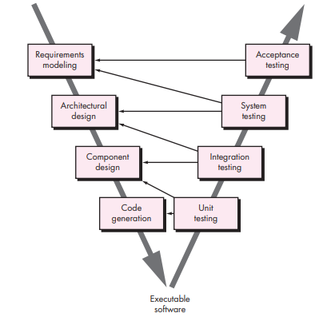
V Model

Slide 12
Rapid Prototyping Process Model
Requirements
Quick Design
Prototype
Evaluate
Design

Slide 13
Rapid Prototyping Model
The Rapid Prototyping Model is used to overcome issues related to understanding and capturing of user requirements.

Slide 14
Evolutionary s/w process Model
Incremental model
Spiral Model

Slide 15
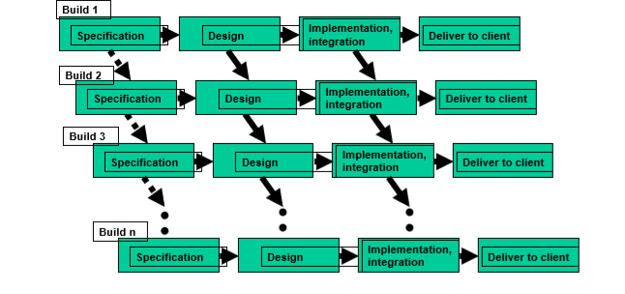
Incremental or Iterative Process Model

Slide 16
Incremental or Iterative Process Model
Rather than deliver the system as a single delivery, the development and delivery is broken down into increments with each increment delivering part of the required functionality.
Once the development of an increment is started, the requirements are frozen though requirements for later increments can continue to evolve.

Slide 17
Incremental or Iterative development advantages
Customer value can be delivered with each increment so system functionality is available earlier.
Early increments act as a prototype to help elicit requirements for later increments.
Lower risk of overall project failure.

Slide 18
Spiral Process Model
The spiral model, originally proposed by Boehm is an evolutionary software process model that couples the iterative nature of prototyping with the controlled and systematic aspects of the linear sequential model.
Using the spiral model, software is developed in a series of incremental releases.

Slide 19
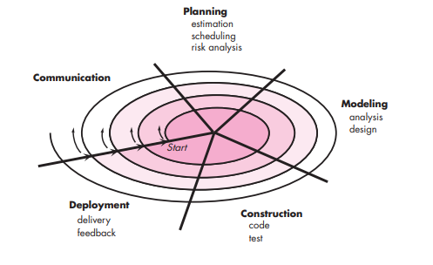
Spiral Process Model

Slide 20
Spiral Model(Description)
Follows an evolutionary approach
Used when requirements are not well understood and risks are high
Operates as a risk-driven model…a go/no-go decision occurs after each complete spiral in order to react to risk determinations
Requires considerable expertise in risk assessment
Serves as a realistic model for large-scale software development
20

Slide 21
General Weaknesses of Evolutionary Process Models
Prototyping poses a problem to project planning because of the uncertain number of iterations required to construct the product
Evolutionary software processes do not establish the maximum speed of the evolution
If too fast, the process will fall into chaos
If too slow, productivity could be affected
21

Slide 22
Requirement engineering

Slide 23
What is Requirement?
What is requirement?
The descriptions of what the system should do
services that it provides and the constraints on its operation

Slide 24
Types of Requirements
Functional requirements:
statement of services
how system reacts to input
how system behaves in particular situation
Non-functional requirements:
constraints on services (timing, quality, security etc.)
Domain requirements
Inverse requirements
Design and implementation constraints

Slide 25
Why Requirement Engineering:
A study based on 340 companies in Austria, more than two thirds consider the SRS as the major problem in development process (1995)
A study on Web applications, 16% systems fully meet their requirement while 53% deployed systems do not (Cutter Consortium, 2000)

Slide 26
Why Requirement Engineering:
A study among 8000 projects, 30% of projects fail before completion & almost half do not meet customer requirements (Standish group, 1994)
Unclear objectives, unrealistic schedules & expectations, poor user participation

Slide 27
The Requirements Process (Process for Capturing Requirements)
Performed by the req. analyst or system analyst
The final outcome is a Software Requirements Specification (SRS) document

Slide 28
Requirement engineering process

Slide 29
Requirements Elicitation identify sources of requirements
Interviewing stakeholders
Reviewing available documentations
Observing the current system (if one exists)

Slide 30
Requirements Elicitation Stakeholders
Clients: pay for the software to be developed
Users: use the system
Domain experts: familiar with the problem that the software must automate

Slide 31
Requirements Elicitation stakeholder list
Auditor
Buyer
Clerical user
Customer service analyst
Database administrator
Financial expert
Sales specialist
Software Architect
Network Administrator
Usability specialist
Security Specialist

Slide 32
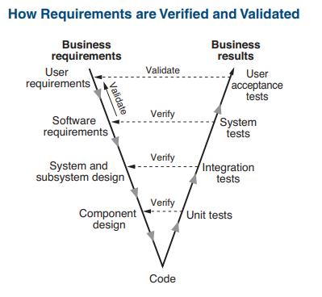
Requirements Elicitation stakeholder list

Slide 33
Requirement Analysis Analysis modeling

Slide 34
Analysis model
Analysis results in requirements models.
Requirements models (also referred to as analysis models) are user requirements represented by diagrams.

Slide 35
Elements of the Analysis Model
Object-oriented Analysis
Structured Analysis
Scenario-based
modeling
Flow-oriented
modeling
Use case text
Use case diagrams
Activity diagrams
Data flow diagrams
Class-based
modeling
Behavioral
modeling
Class diagrams
CRC models
Collaboration diagrams
State diagrams
Sequence diagrams

Slide 36
Flow-Oriented Modeling

Slide 37
What is a Data Flow Diagram?
A data flow diagram (DFD) is a graphical tool that allows system analysts (and system users) to depict the flow of data in an information system.

Slide 38
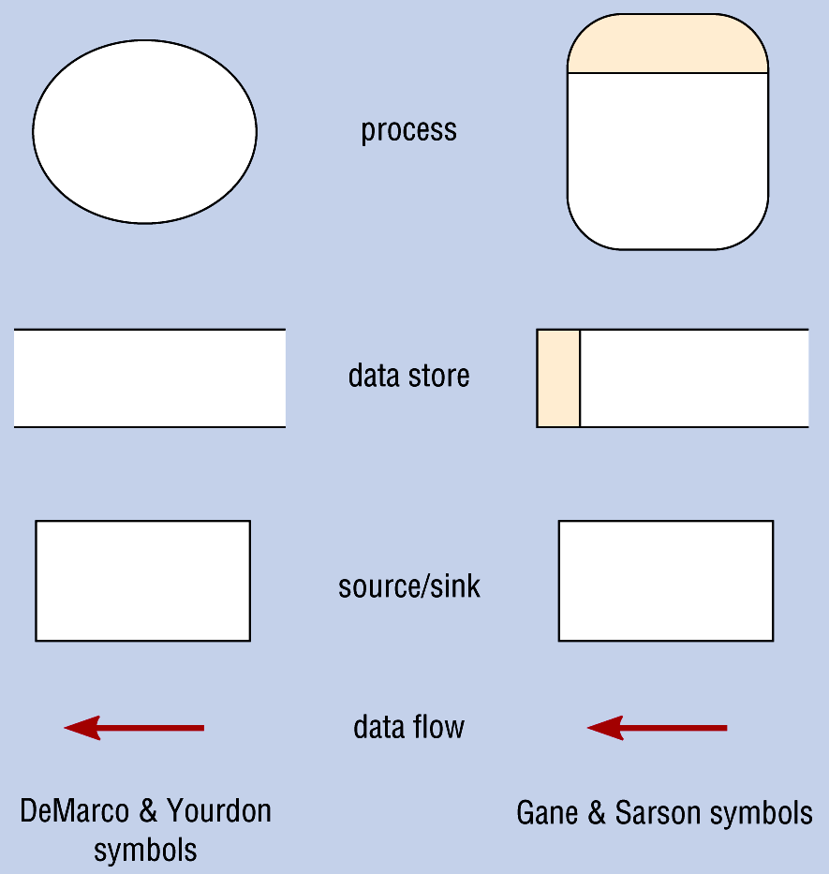
Data Flow Diagram Symbols
Source

Slide 39
Steps in Building DFDs
Build the context diagram
Create DFD fragments
Organize DFD fragments into level 0
Decompose level 0 DFDs as needed

Slide 40
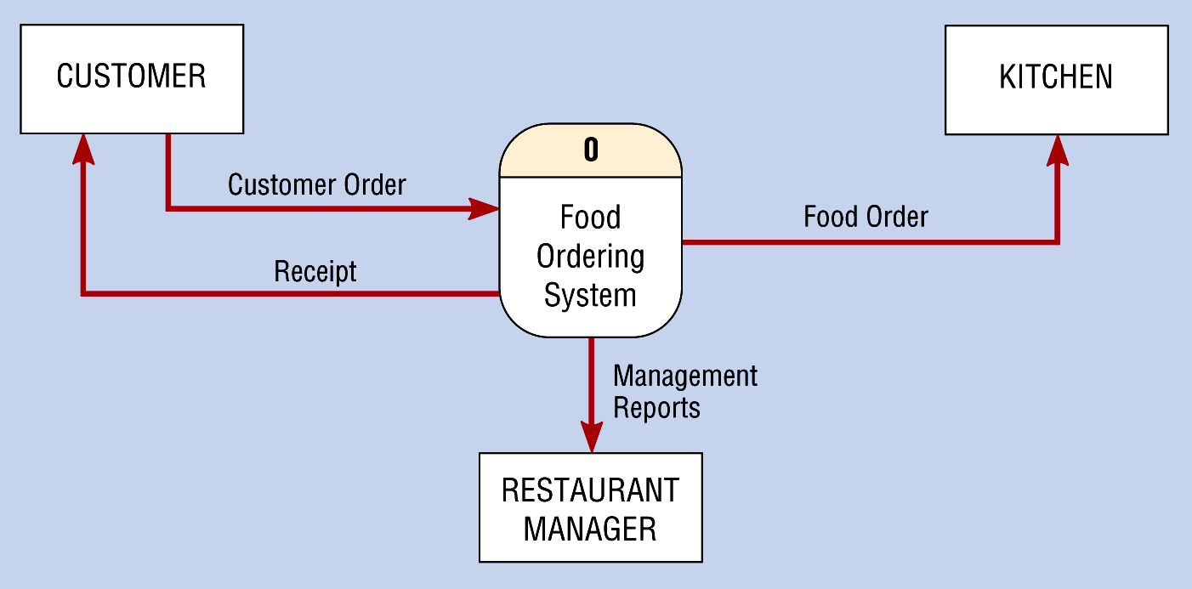
Context Diagram of Food Ordering System

Slide 41
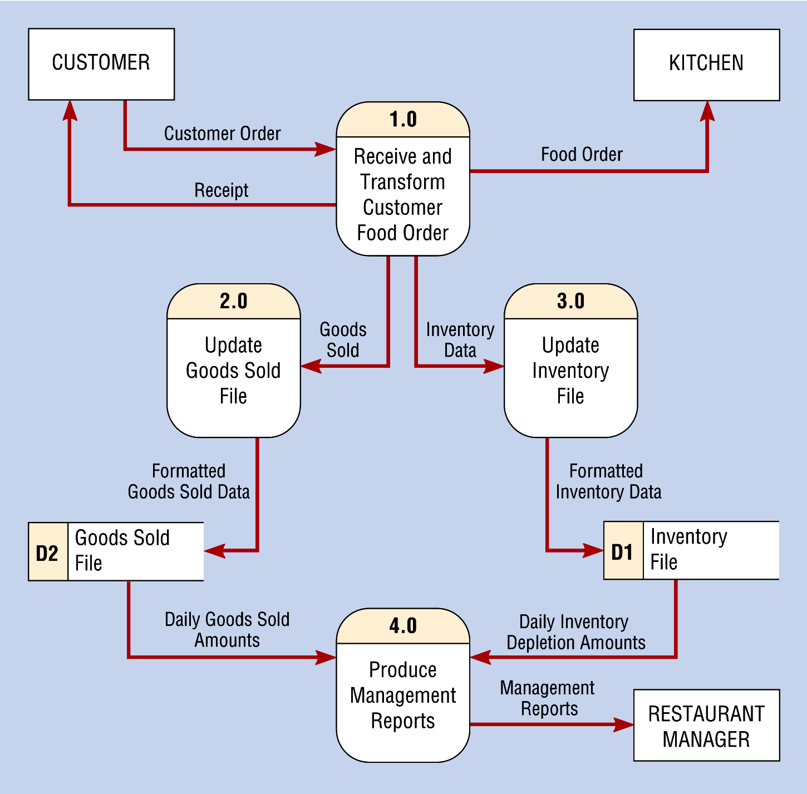
Level-0 DFD of Food Ordering System

Slide 42
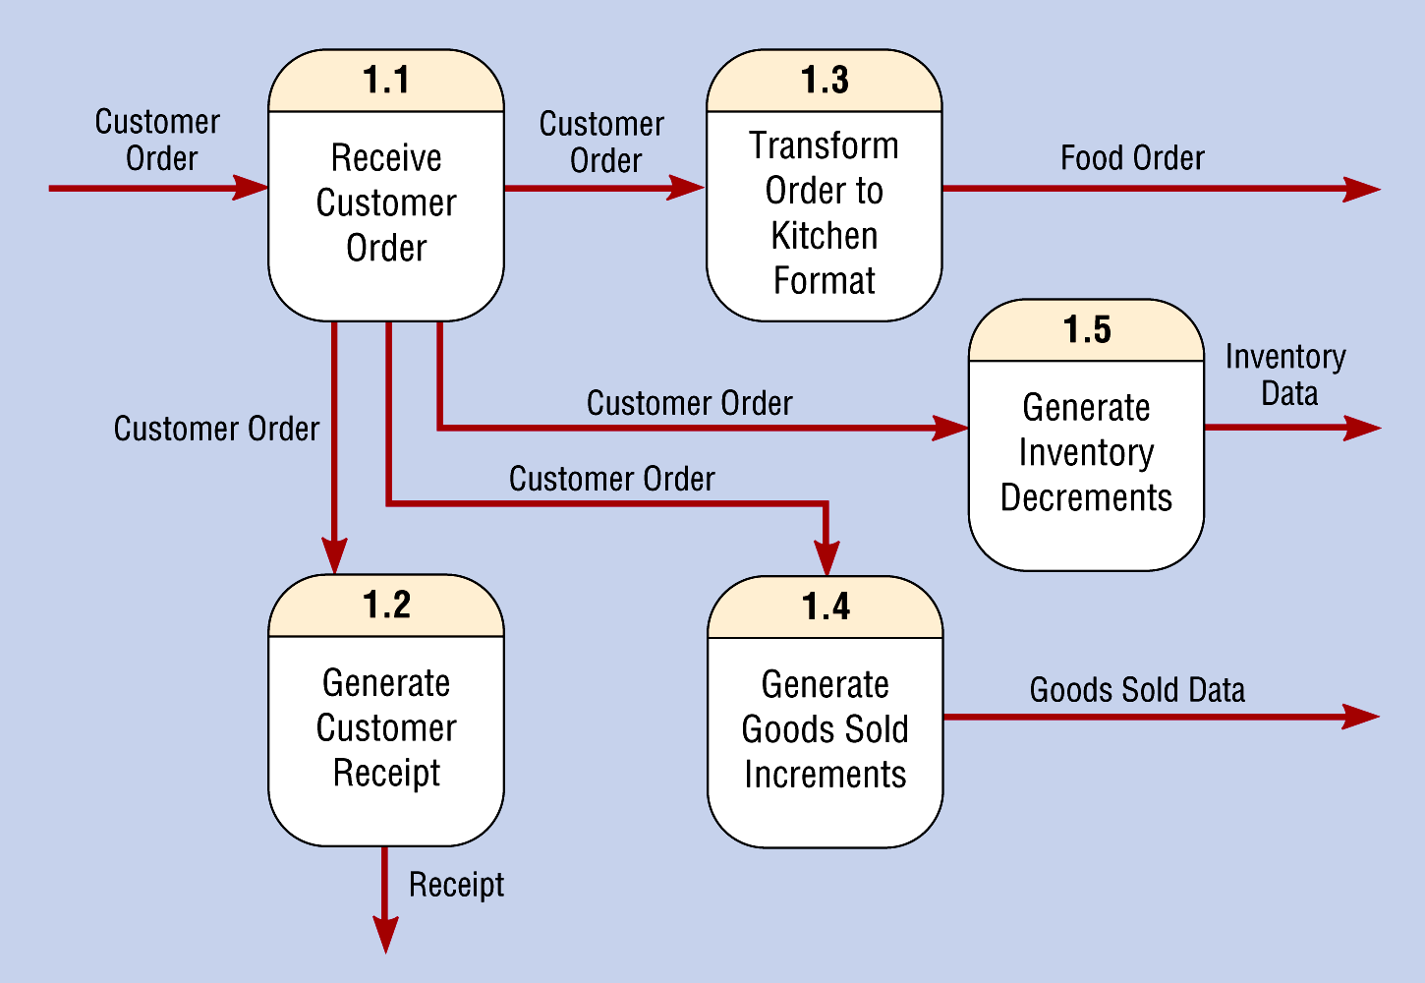
Level-1 Diagram Showing Decomposition of Process 1.0 from the Level-0 Diagram

Slide 43
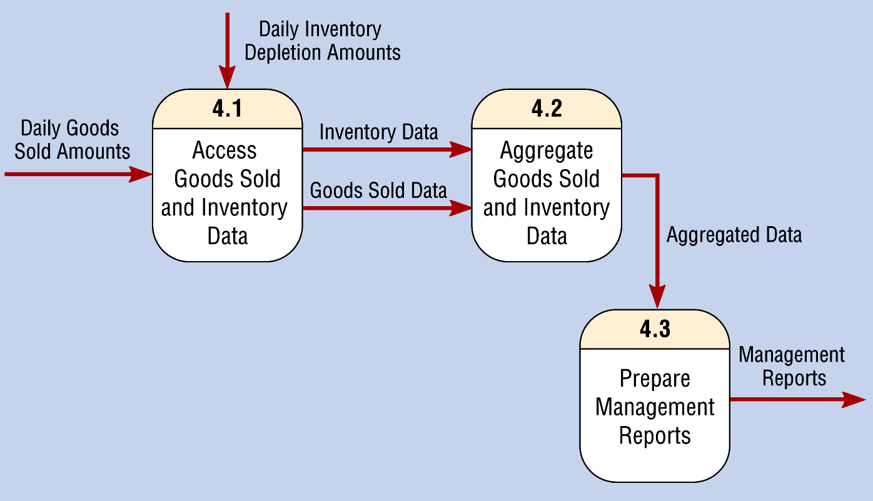
Level-1 Diagram Showing the Decomposition of Process 4.0 from the Level-0 Diagram

Slide 44
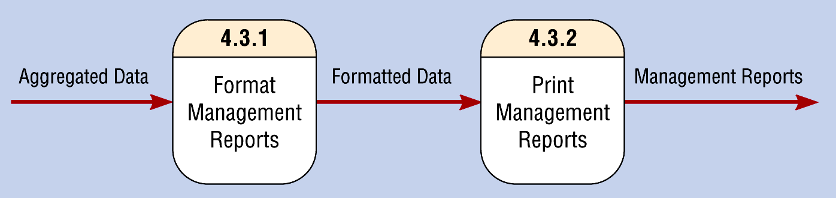
Level-2 Diagram Showing the Decomposition of Process 4.3 from the Level-1 Diagram for Process 4.0

Slide 45
Data Flow Diagram of safe home system

Slide 46
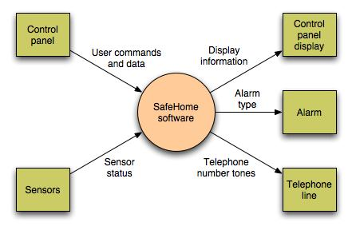
Data Flow Diagram
Context-level DFD for SafeHome security function

Slide 47
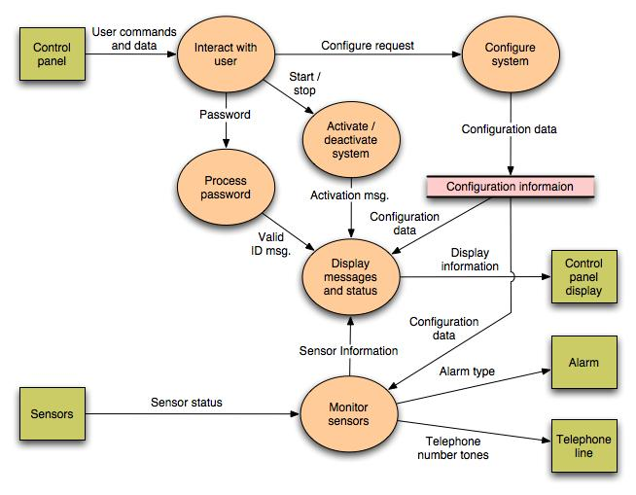

Slide 48
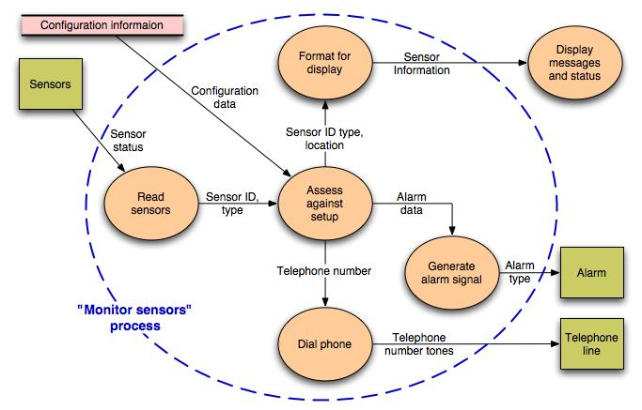
Level 2 DFD that refines the monitor sensors process

Slide 49
HAVE A GOOD DAY!

